Slide 1
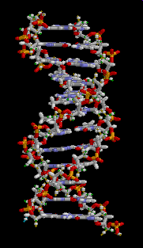
C h a p t e r 7
EXPRESSİONS
AND CONTROL FLOW

Slide 2
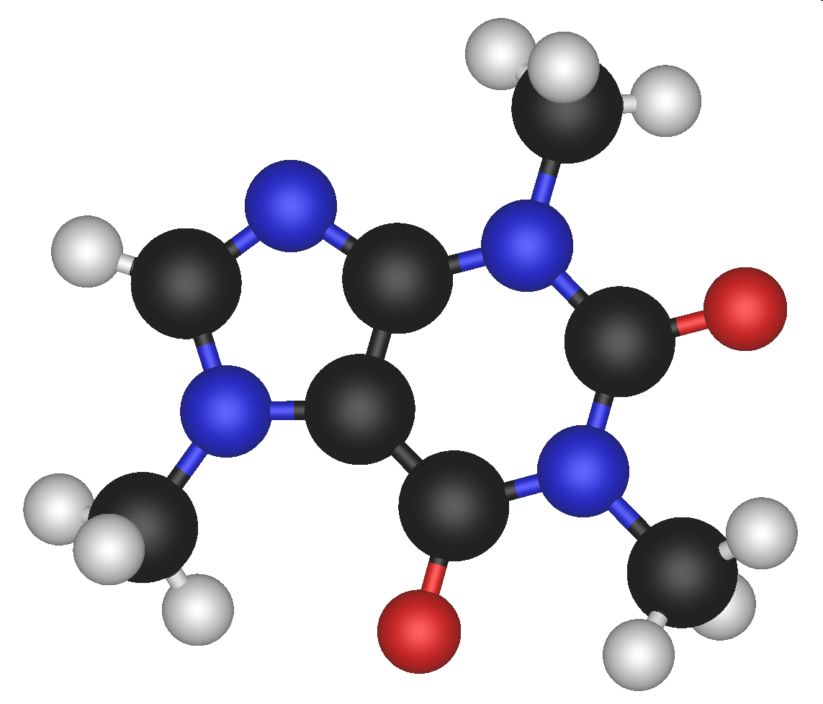
Expressions
An expression is a PL construct that may be evaluated to yield a value.
Forms of expressions:
  literals (trivial)
  constant/variable accesses (trivial)
  Constructions (aggregation of these)
  function calls (&operations)
  conditional expressions

Slide 3
Constructions
A construction is an expression that constructs a composite value from its component values.
Example: Ada Record Construction
type Date is record
m: Month;
d: Day_Number;
end record;

Slide 4
Function Calls
A function call computes a result by applying a function to some arguments.
arg1
Function
result
arg2
arg3
Evaluate
Construct

Slide 5
Operations are just Function Calls
An operator may be thought of as denoting a function.
Applying a unary operator ⊕ to its operand is essentially a function call with one argument:
  ⊕ E is essentially equivalent to ⊕(E)
Applying a binary operator ⊗ to its operands is essentially a function call with two arguments:
  E₁ ⊗ E₂ is essentially equivalent to ⊗(E₁, E₂)
Thus a conventional arithmetic expression is essentially equivalent to a composition of function calls:
  a * b + c / d is essentially equivalent to
  +(*(a, b), /(c, d))

Slide 6
Conditional expressions
Java if-expression:
  x>y ? x : y
Conditional expressions tend to be more elegant than conditional commands. Compare:
  int max1 (int x, int y) {
  return (x>y ? x : y);
  }
  int max2 (int x, int y) {
  if (x>y)
  return x;
  else
  return y;
  }

Slide 7
Arithmetic Expressions: Design Issues
Design issues for arithmetic expressions
  operator precedence rules
  operator associativity rules
  order of operand evaluation
  operand evaluation side effects
  operator overloading
  mode mixing expressions

Slide 8
Prescedence
The operator precedence levels for expression evaluation define the order in which “adjacent” operators are evaluated by choosing between operators.
Typical precedence levels
  parentheses
  unary operators
  ** (if the language supports it)
  *, /
  +, -

Slide 9
Associativity
The operator associativity rules for expression evaluation define the order in which adjacent operators are evaluated in terms of a general positional rule.
Precedence rules have precedence over associativity rules.
So the associativity rules work on the same operator precedence level.

Slide 10
Precedence of C-based operators
  postfix ++, --
  unary +, -, prefix ++, --, !
  *,/,%
  binary +, -
  <, >, <=, >=
  =, !=
  &&
  ||

Slide 11
a < b < c is a legal expression in C,
but the result is not what you might expect:
  Left operator is evaluated, producing 0 or 1
  The evaluation result is then compared with the third operand (i.e., c)

Slide 12
Potentials for Side Effects
Functional side effects: when a function changes a two-way parameter or a global variable
Problem with functional side effects:
  When a function referenced in an expression alters another operand of the expression; e.g., for a parameter change:
a = 10;
/* assume that fun changes its parameter */
b = a + fun(a);

Slide 13
Side Effects…
Two possible solutions to the problem
  Write the language definition to disallow functional side effects
    No two-way parameters in functions
    No non-local references in functions
    Advantage: it works!
    Disadvantage: inflexibility of two-way parameters and non-local references
  Write the language definition to demand that operand evaluation order be fixed
    Disadvantage: limits some compiler optimizations

Slide 14
Short Circuit Evaluation
An expression in which the result is determined without evaluating all of the operands and/or operators
Example:
  (13*a) * (b/13–1)
  If a is zero, there is no need to evaluate (b/13-1)
  sayac=5;
  if (sayac>0) || (toplam <1000) ...

Slide 15
Problem with non-short-circuit evaluation
  index = 1;
  while (index <= length) && (LIST[index] != value)
  index++;
  When index=length, LIST [index] will cause an indexing problem (assuming LIST has length -1 elements)

Slide 16
Operator Overloading
Use of an operator for more than one purpose is called operator overloading
Some are potential trouble (e.g., * in C and C++)
  Loss of compiler error detection (Compiler can not know if the correct operator is meant)
  Some loss of readability

Slide 17
Type Conversions
A narrowing conversion is one that converts an object to a type that cannot include all of the values of the original type e.g., float to int
A widening conversion is one in which an object is converted to a type that can include at least approximations to all of the values of the original type e.g., int to float

Slide 18
Mixed Mode Expressions
A mixed-mode expression is one that has operands of different types
A coercion is an implicit type conversion
Disadvantage of coercions:
  They decrease in the type error detection ability of the compiler
In most languages, all numeric types are coerced in expressions, using widening conversions
In Ada, there are virtually no coercions in expressions.

Slide 19
Explicit Type Conversions
Explicit Type Conversions
Called casting in C-based language
Examples
  C: (int) angle
  Ada: Float (sum)

Slide 20
Unary Assignment Operators
Unary assignment operators in C-based languages combine increment and decrement operations with assignment
Examples
  count++ (count incremented)
  sum = ++count (count incremented, assigned to sum)

Slide 21
Assignment as an Expression
In C, C++, and Java, the assignment statement produces a result and can be used as operands
An example:
while ((ch = getchar())!= EOF){…}
ch = getchar() is carried out; the result (assigned to ch) is used as a conditional value for the while statement

Slide 22

Control Structures
A control structure is a control statement and the statements whose execution it controls

Slide 23
Two-Way Selection Statements
General form:
if control_expression
then clause
else clause

Slide 24
Nesting Selectors
Java example
  if (sum == 0)
if (count == 0)
result = 0;
else result = 1;
Which if gets the else?
Java's static semantics rule: else matches with the nearest if

Slide 25
Multiple-Way Selection
Early multiple selectors:
  FORTRAN arithmetic IF (a three-way selector)
IF (arithmetic expression) N1, N2, N3
  Segments require GOTOs
  Not encapsulated (selectable segments could be anywhere)

Slide 26
Modern multiple selectors
  C’s switch statement
switch (expression)
{
case const_expr_1: stmt_1;
…
case const_expr_n: stmt_n;
[default: stmt_n+1]
}

Slide 27
Design choices for C’s switch statement
  Control expression can be only an integer type
  Selectable segments can be statement sequences, blocks, or compound statements
  Any number of segments can be executed in one execution of the construct (there is no implicit branch at the end of selectable segments)
  default clause is for unrepresented values

Slide 28
Iterative Statements
The repeated execution of a statement or compound statement is accomplished either by iteration or recursion
General design issues for iteration control statements:
  1. How is iteration controlled?
  2. Where is the control mechanism in the loop?

Slide 29
Counter-Controlled Loops
A counting iterative statement has a loop variable, and a means of specifying the initial and terminal, and stepsize values
Design Issues:
  What are the type and scope of the loop variable?
  What is the value of the loop variable at loop termination?
  Should it be legal for the loop variable or loop parameters to be changed in the loop body, and if so, does the change affect loop control?
  Should the loop parameters be evaluated only once, or once for every iteration?

Slide 30
C’s for statement
  for ([expr_1] ; [expr_2] ; [expr_3]) statement
The expressions can be whole statements, or even statement sequences, with the statements separated by commas
  The value of a multiple-statement expression is the value of the last statement in the expression
There is no explicit loop variable
Everything can be changed in the loop
The first expression is evaluated once, but the other two are evaluated with each iteration

Slide 31
The expression for the initial value, step value and the final value are all optional.
Since there is no special loop variable, all the values can be changed within the loop.
for (a =0, b=50;
a<10 && b<900;
c= ++a + b, b *= 2);

Slide 32
Iterative Statements: Logically-Controlled Loops
Repetition control is based on a Boolean
Design issues:
  Pre-test or post-test?
  Should the logically controlled loop be a special case of the counting loop statement ? expression rather than a counter
General forms:
while (ctrl_expr) do
loop body loop body
while (ctrl_expr)

Slide 33
Iterative Statements: Logically-Controlled Loops: Examples
Pascal has separate pre-test and post-test logical loop statements (while-do and repeat-until)
C and C++ also have both, but the control expression for the post-test version is treated just like in the pre-test case (while-do and do- while)
Java is like C, except the control expression must be Boolean (and the body can only be entered at the beginning -- Java has no goto)

Slide 34
Break/Exit Continue
-
-
continue
-
break
-
-
-

Slide 35
Exit:
for j=1 to 100
input puan
if puan < 0 then exit for
toplam = toplam + puan
end
Break:
scanf("%d", &deger);
while deger > 0
{
if deger mod 3 = 0 break;
toplam = toplam + deger;
scanf("%d", &deger);
}

Slide 36
while ( toplam <1000){
scanf( "%d",&puan);
if (puan < 0) continue;
toplam += puan;
……
}

Slide 37
Unconditional Branching
Transfers execution control to a specified place in the program
Represented one of the most heated debates in 1960’s and 1970’s
Well-known mechanism: goto statement
Major concern: Readability
Some languages do not support goto statement (e.g., Module-2 and Java)
C# offers goto statement (can be used in switch statements)
Loop exit statements are restricted and somewhat camouflaged goto’s

